Slide 1
JavaScript Class CSS L1
HTML/CSS Intro
No background needed!

Slide 2
References
HTML and CSS: the Good Parts
Author: Ben Henick
Publisher: O’Reilly Media, Inc.
Pub Date: 2/18/2010
CSS: The Missing Manual
Author: David Sawyer McFarnald
Publisher: O’Reilly Media, Inc.
Pub Date 8.24.2009
Notes:
We are going to cover all the material in these 2 books in the CSS section of this class.

Slide 3
Class Sites
Stanford cs193c
University of Washington INFO 343
FE focus, no server programming, building portfolio as a demonstration of ability
University of Washington INFO 344
Apache Server, php, mysql db, jQuery AJAX, cookies & sessions, DOM, XML, JSON
Notes:
We aren’t going to cover tables as in cs193c
We aren’t going to do DBs or PHP in INFO344.
We will do Java Servlets as an addendum to AJAX because Java scales in the enterprise and is more prevalant for those seeking jobs.

Slide 4
CSS Hands on Programming Goal
Reverse engineer existing web sites, practice WYSWIG CSS coding skills using csszengarden variations as a template with tutorials from CSS: The missing manual to develop the theory.

Slide 5
Course Outline
HTML/CSS Goal(6 lectures): Reverse Engineer webpage designs, start with CSS ZenGarden
JavaScript(4 lectures): Events, DOM
AJAX(2 lectures): Basic Servlet Programming, AJAX
Javascript(4 lectures): OO JS, Implementing jQuery, YUI, Prototype, CouchDB
Mixing Frameworks, extJS, jQuery, YUI, performance of table driven i/f, performance of nosql, etc…

Slide 6
Tools
FF Browser Tools
Install Firebug, DEMO
Install Web Developer DEMO
IE/Chrome Demo
Eclipse/VS/TextEditor HTML Editor

Slide 7
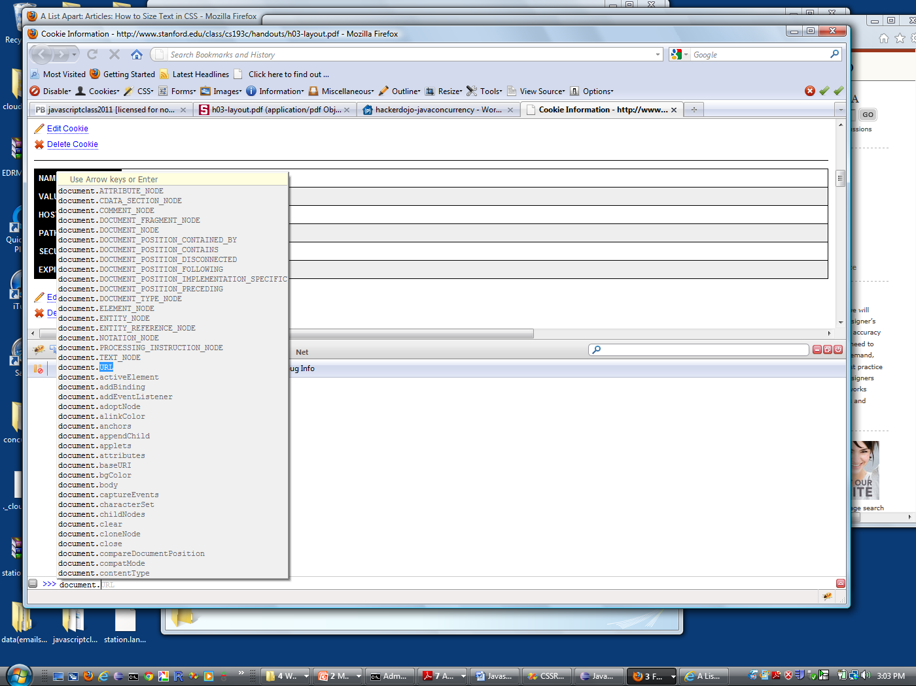
Firebug Demo

Slide 8
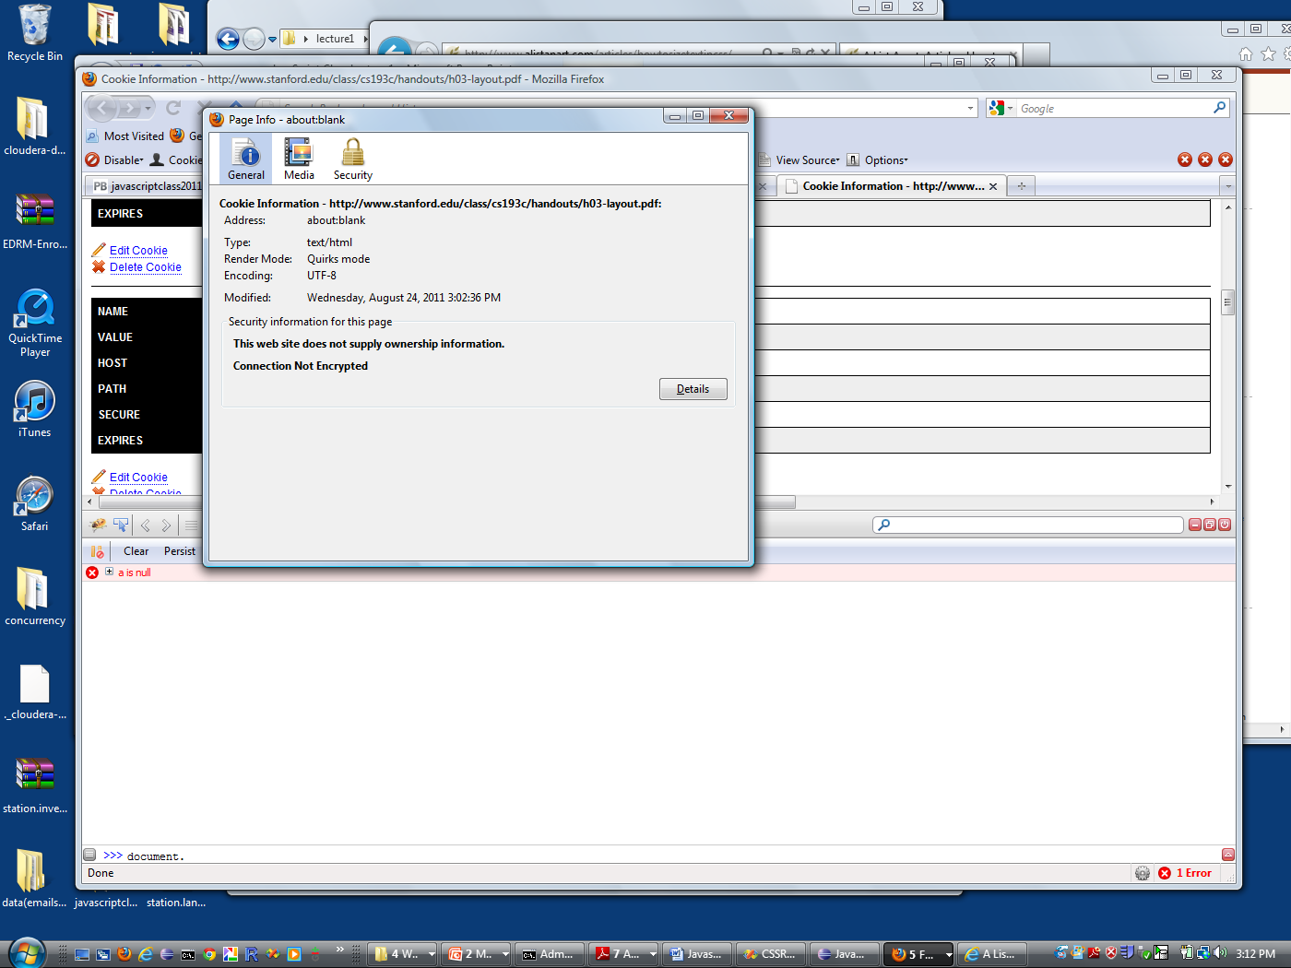
Web Developer Demo
Notes:
Display a pdf page, says quirks mode.
Goto URL: http://www.stanford.edu/class/cs193c/handouts/h03-layout.pdf
w

Slide 9
Structure of a blank webpage
Browser>>View Source
HTML Templates from Visual Studio and Eclipse
HTML 4.01: http://www.w3.org/TR/html401/
XHTML 1.0 http://www.w3.org/TR/xhtml1/
HTML 5: http://dev.w3.org/html5/spec/Overview.html
Files: L1.html (HTML4.01), HTMLPage1.html (XHTML1.0), BlankHTML5Page.html (HTML5)
Notes:
Cover the 3 different standards. Class Question:Why are there 3 different standards? What is the functional difference? XHTML requires closing tags, no optional. Closer to xml grammar standards
Covered in Ch2 HTML&CSS The good parts.
HTML first, different user-agents or browsers implemented the specification differently. HTML has optional </p> and </li> tags. Problem was parsing the optional combinations. There was no limit to the potential nesting. Impossible to build a nonambiguous parser to support this.
XHTML removed the optional tag part either a closing tag was required or forbidden. This made the grammar well behaved and implementable.
A minimum webpage needs HTML, body

Slide 10
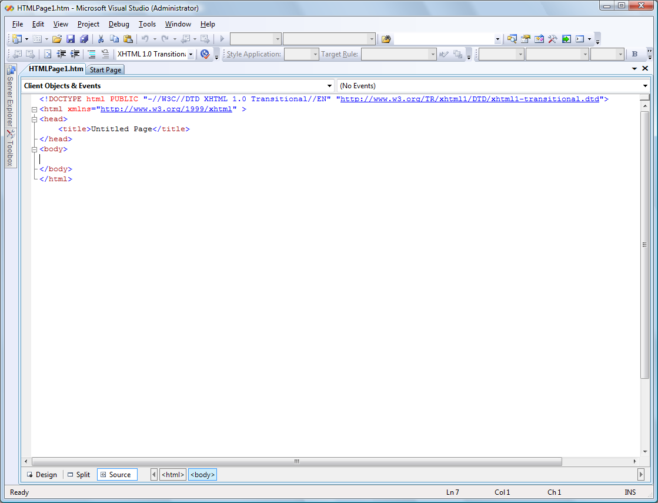

Slide 11
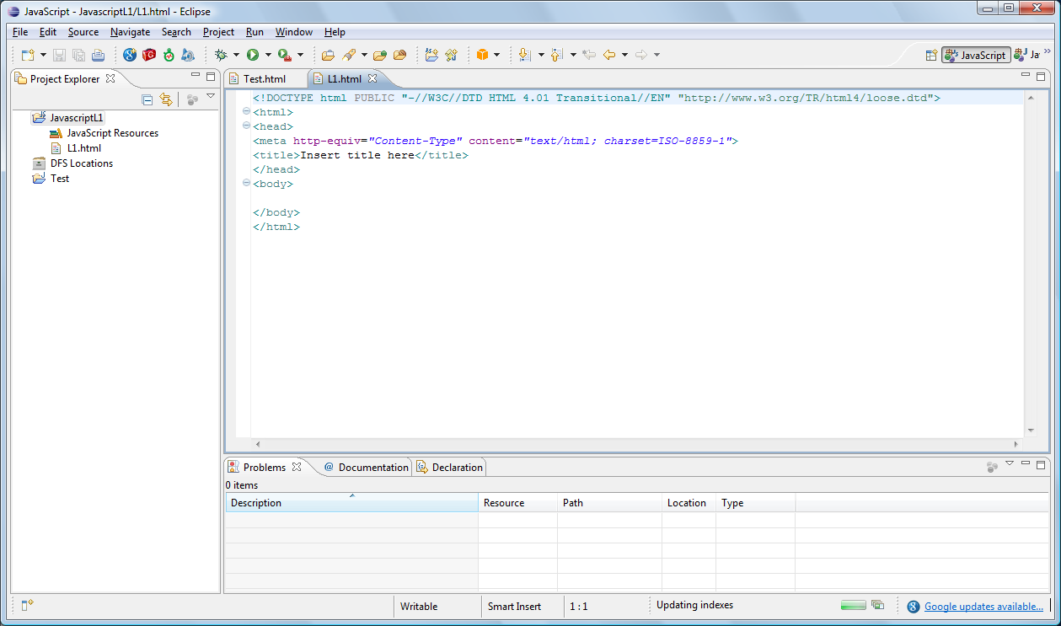

Slide 12
HTML Structure/Validators
Doctypes => Browser Rendering Modes.
Quirks Mode, Standards Mode, Almost Standards mode. http://hsivonen.iki.fi/doctype/
Types of Doctypes, Strict, Loose, Transitional
Doctype sniffing: http://reference.sitepoint.com/css/doctypesniffing
Use XHTML 1.0
Submit your webpage to a validator -- DEMO
CSS Validator (X)HTML Validator
Refer to Ch14 HTML & CSS: The good parts for discussion on evolution of standards, browser support, IE 6 issues, etc..

Slide 13
HTML Elements and Attributes
CSS Missing Manual Ch 1-5
HTML Elements, tags and attributes
<a href="http://www.w3schools.com">This is a link</a>
HTML Standard Attributes
HTML Event Attributes
Nothing to do with CSS for now
DEMO (HTML Attributes)
Notes:
The tag is “a” the attribute is the attribute name=“value”
Attribute names are left side of =, Attribute values are RHS of =

Slide 14
CSS Rules
From the demo we saw how HTML attribute values causes changes in the browser rendering engine.
2 Parts to a browser HTML=>DOM Tree, CSS Rules=>Layout Engine
Design goal: separate presentation of the HTML from the HTML code.
CSS ZenGarden. Same HTML, different webpages. DEMO (CSS ZenGarden Demos)

Slide 15
CSS Rules
Parts of a CSS Rule
<h1> This is red</h1>
How do we make the text red?
Put HTML styles in a HTML <style> tag. CSS selector, css property, css value.
Style tags don’t support event attributes, only std attributes. Event attributes are modified using JS.
<style type="text/css">
h1
{
color:red;
}

Slide 16
CSS Font Sizes, Colors
Colors ColorWheel
color=#345533 hexadecimal format for RGB
color=rgb(3,44,33); decimal format(0-255) for RGB
color=red; limited range
color=rgb(50%,20%,40%);
font-size (default values),
1 em; em size system from typography an em is the default font size in browsers, mostly the browser default setting is 16px. em refers to parent size of font. Not an absolute size. Good for designing in proportions. Em is an Inherited property
100%, current font size.
14pt, fixed size, one pt=1/72 inch
10px, pixel is fixed size, one pixel on display unit
xx-small, x-small, small, medium, large, x-large, xx-large
Design using Body as percentage, Text size in ems, line height in pixels
http://www.alistapart.com/articles/howtosizetextincss/

Slide 17
CSS Tutorial 2.5 Creating inline styles
Start with basic.html downloaded from http://sawmac.com/
Before After
Add <h1 style = “color:#c7AA8D”>

Slide 18
CSS Tutorial 2.5 Creating internal style sheets

Slide 19
CSS Tutorial 2.5 External StyleSheet

Slide 20
Selectors
Tag Selectors
Class Selectors
ID Selectors
PseudoClasses/Elements
Tutorial: Selector Sampler

